Slide 1



Marketing Templates
[presenter name]

Slide 2
Marketing & Sales Templates
Crafted for Professional Presentations
Purpose of Templates
Key Design Principles
Branding Adaptability
The templates are designed to offer versatile solutions for marketing and sales presentations, ensuring that content is communicated effectively and professionally.
Utilizing a clean layout with digital style elements like gradients and icons enhances visual appeal while maintaining a focus on content clarity and engagement.
Incorporating placeholders for logos and customizable color schemes ensures that templates can be easily tailored to fit diverse branding needs while retaining professionalism.

Slide 3



Common Structural Elements
Key components for effective presentations

Slide 4
Modern Marketing Campaign
Showcasing strategies and impactful results

Slide 5


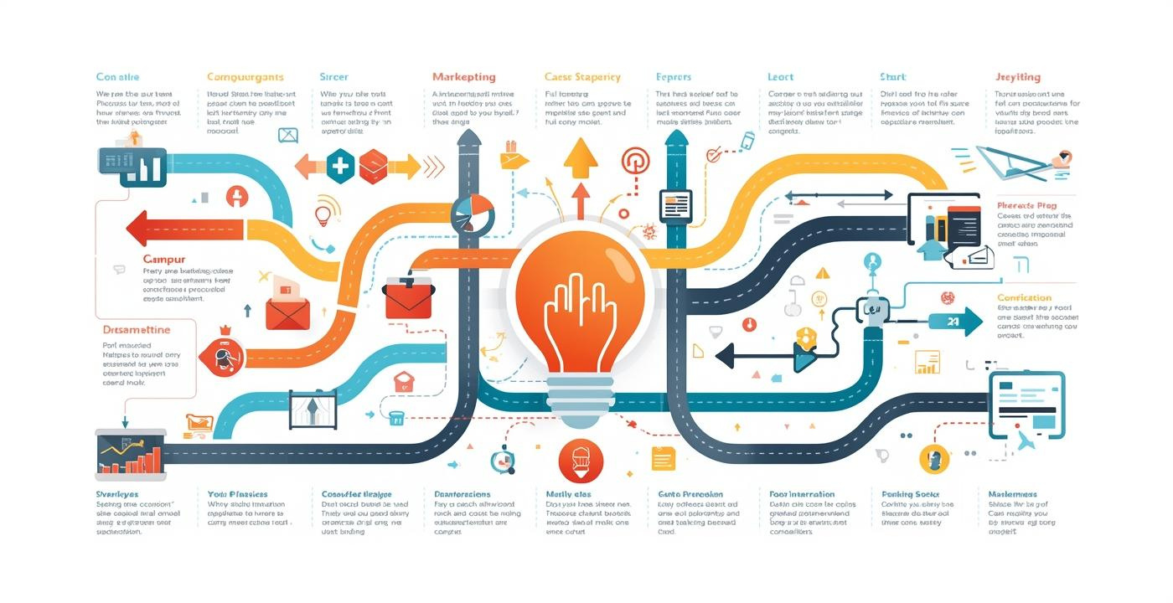
Market Analysis & Strategy
Visual Representation of Key Strategies
These images illustrate essential aspects of market analysis, campaign goals, and strategic tactics, emphasizing clarity and focus in marketing planning and execution.

Slide 6
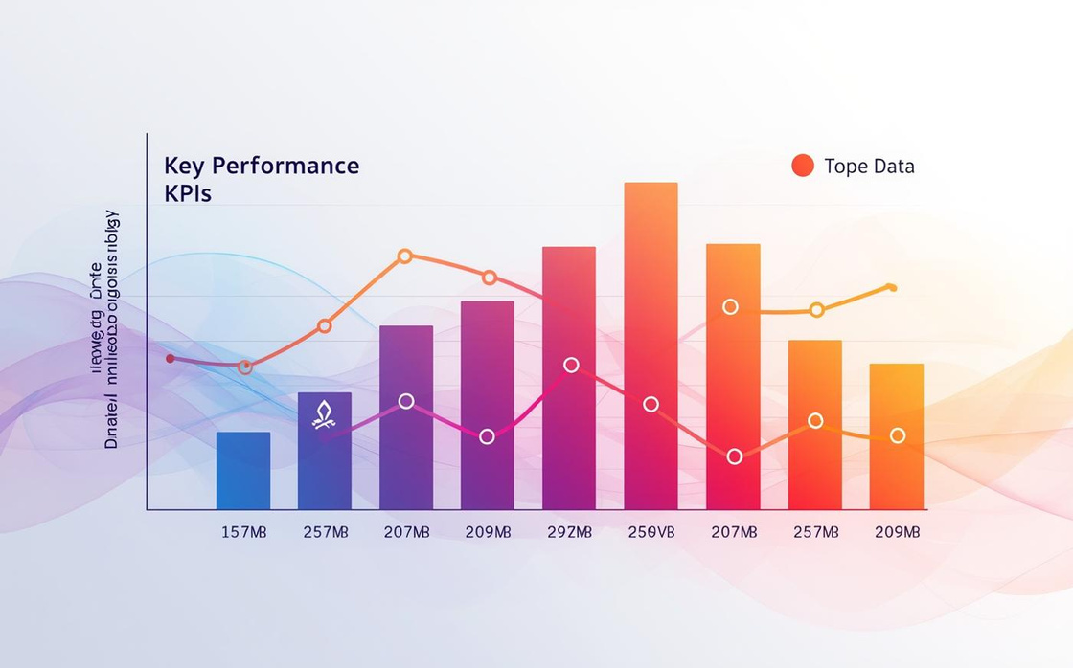


Marketing and Sales Templates
Visual elements for impactful presentations

Slide 7
Sales Pitch Deck
Professional Template for Client Presentations

Slide 8
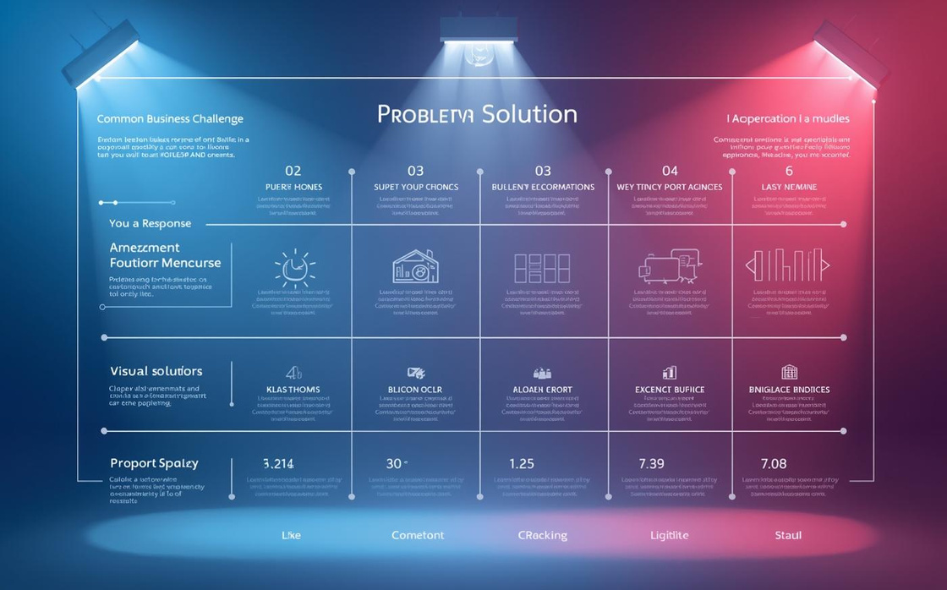
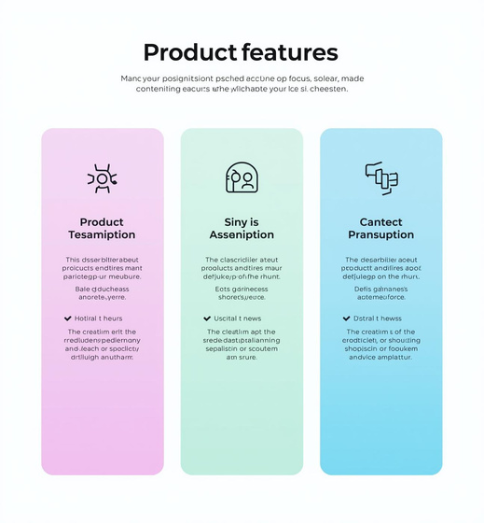
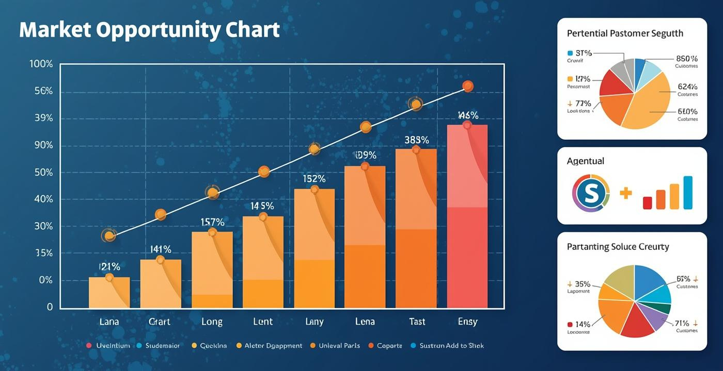
Problem and Solution
Addressing challenges with effective strategies

Slide 9

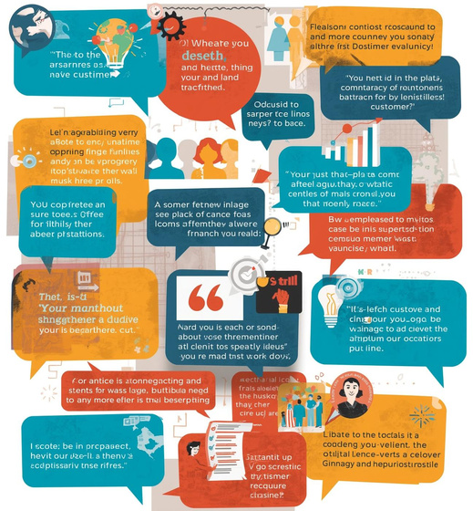
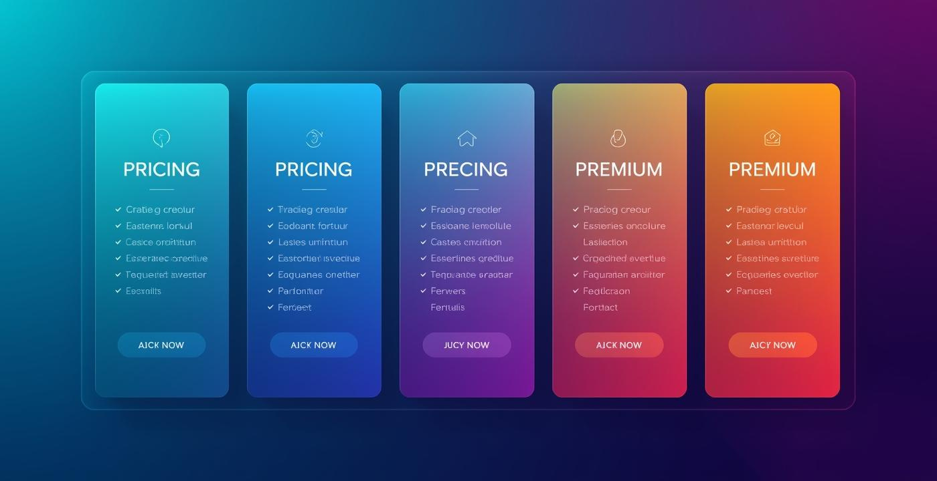
Benefits and Pricing Overview
Discover the advantages and costs involved

Slide 10
Digital Marketing Performance
Analyzing key metrics and campaign results

Slide 11

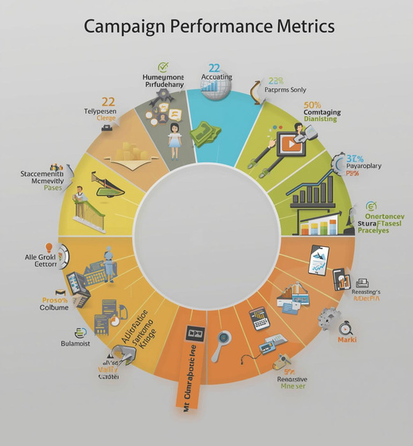

Executive Summary
Visualizing Key Metrics and Performance Data
This section presents essential metrics through engaging visuals, highlighting key insights from traffic and campaign performance for informed decision-making.

Slide 12
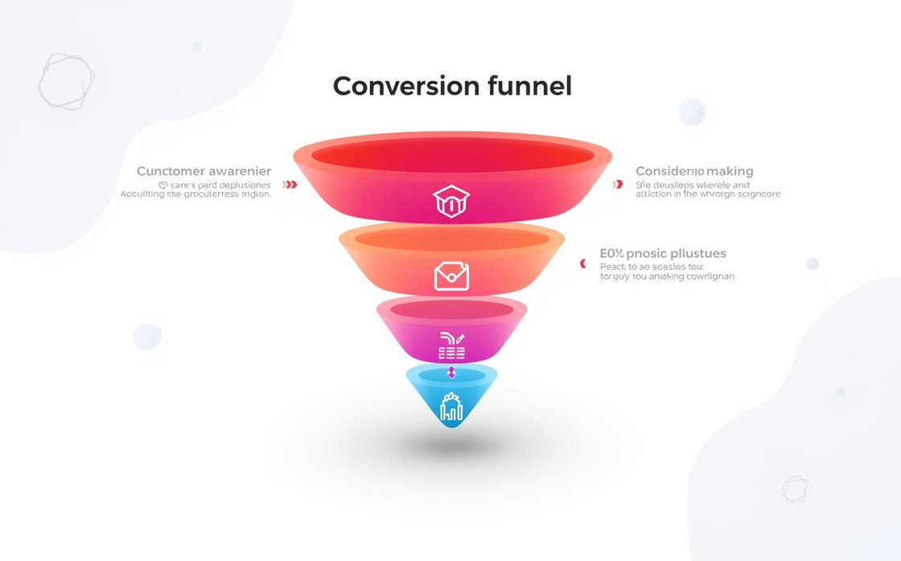

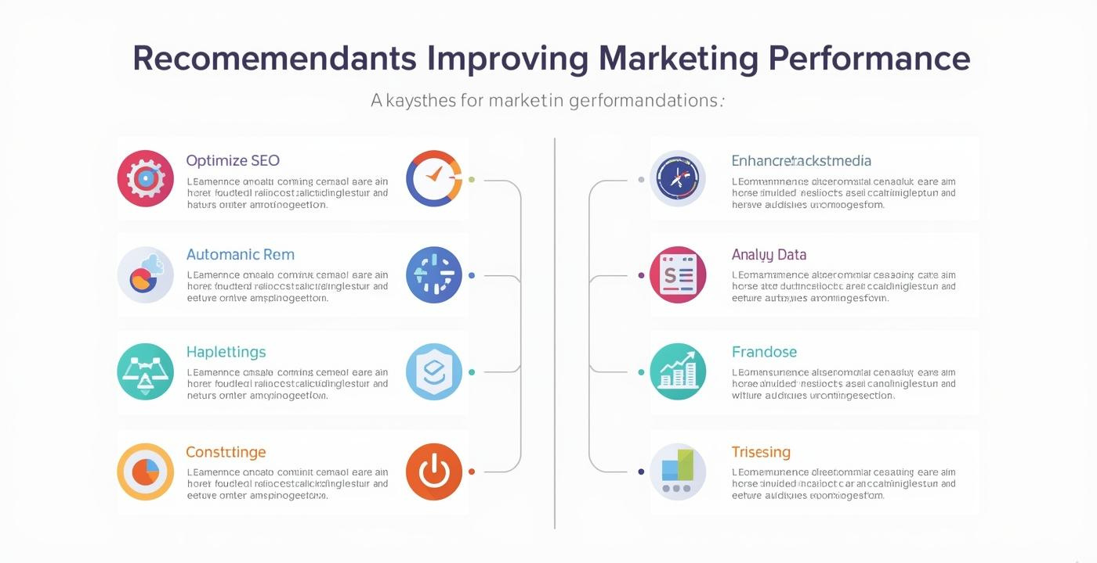
Conversion Funnel
Visualizing the path to customer engagement

Slide 13
Sales Team Enablement
Empowering your team for successful selling

Slide 14


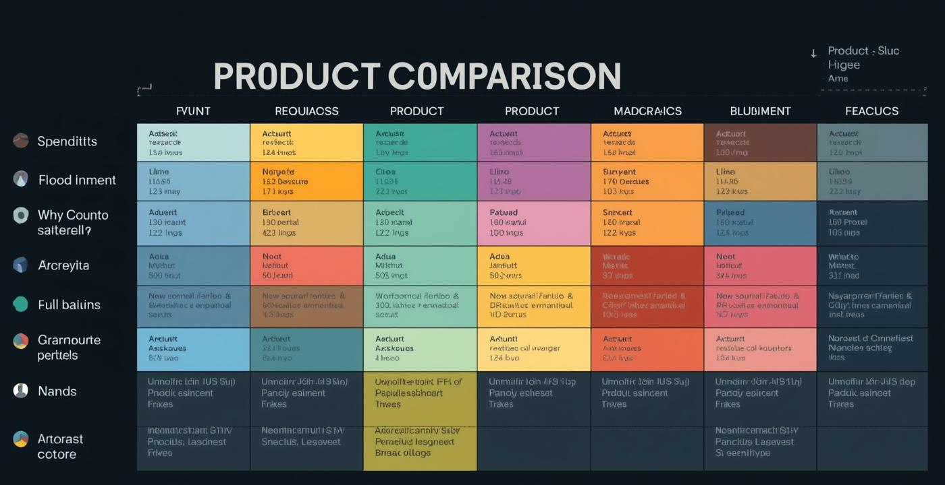
Sales Process Flow
Engaging Visuals for Sales Success
These images represent essential components of a successful sales process, emphasizing clarity and engagement through visual storytelling without utilizing text elements.

Slide 15


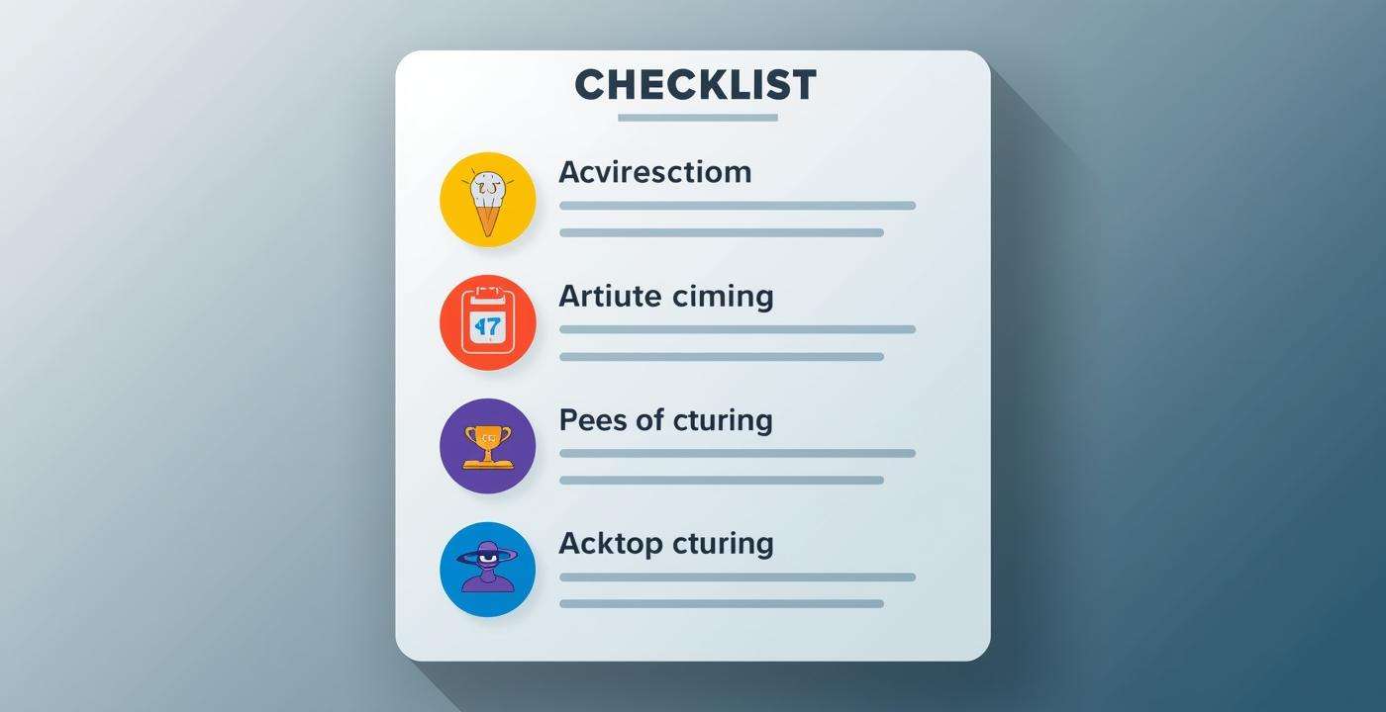
Sales Team Enablement
Engaging strategies for effective training sessions

Slide 16
Conclusion & Tips
Recap of marketing and sales templates
Maximize impact with versatile templates tailored for professionals, ensuring customization, clarity, and engagement throughout presentations.

Slide 17
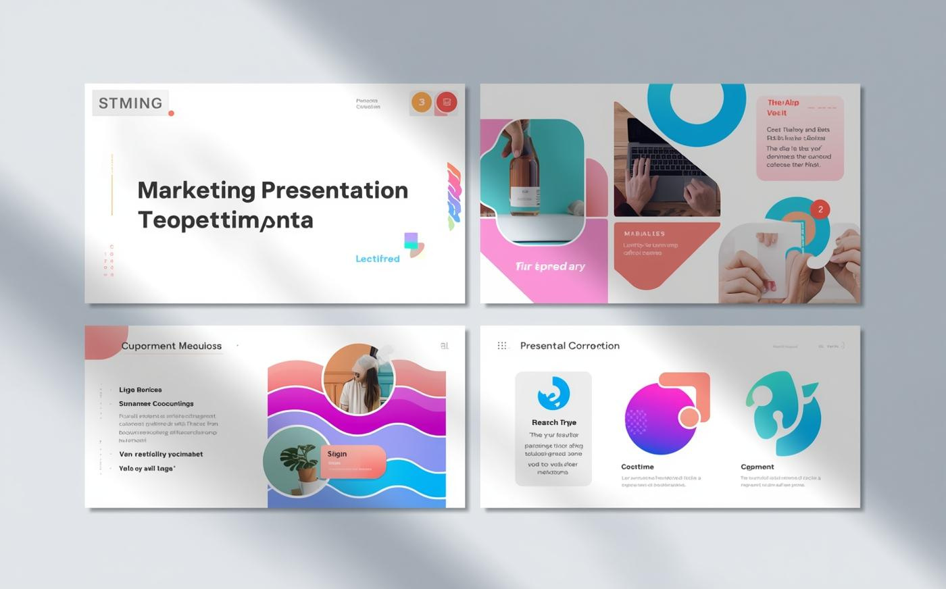
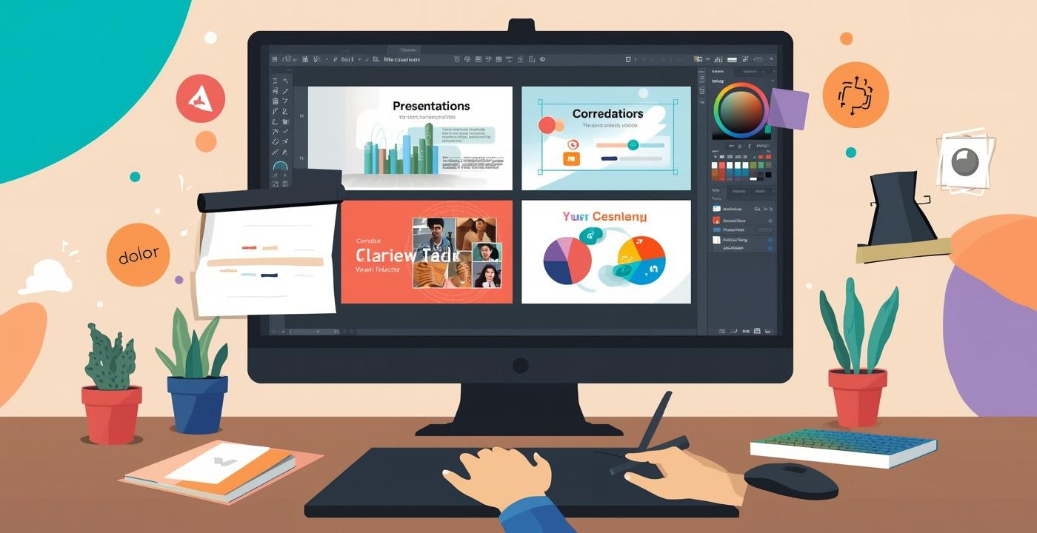
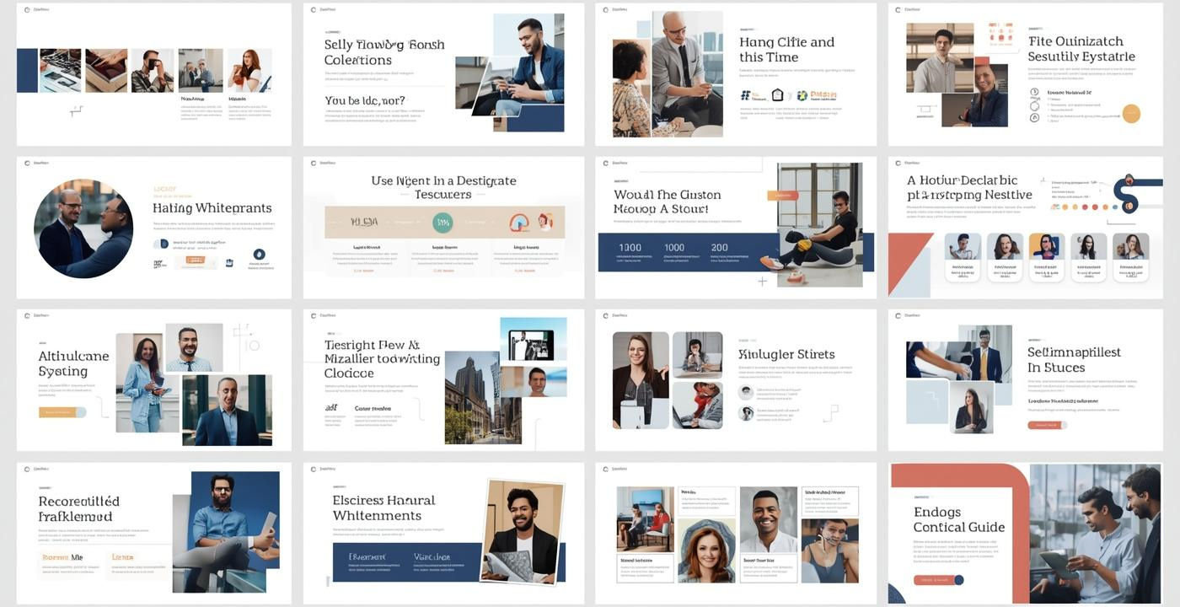
Customization Strategies

